Slide 1
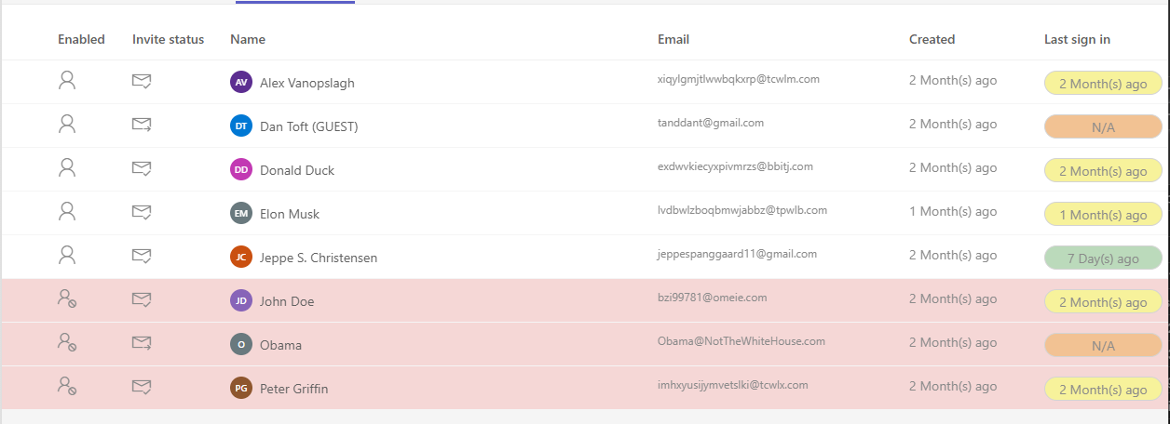

Guest User Overview
Hack Together Microsoft Teams Global Hack 🏆 Productivity Winner

Slide 2



Dan Toft
Microsoft 365 Consultant Denmark
Blog.Dan-Toft.dk
@Tanddant

Slide 3

Jeppe Spanggaard
Microsoft 365 Consultant Denmark
Jeppe-Spanggaard.dk
@JeppeSC11

Slide 4
Agenda
Demo
Why we built it
How we built it
Code
Summary

Slide 5

Notes:
Backup

Slide 6

Why we built it
Filters require knowledge of what you’re looking for
Hard to see what the guest have access to
Who’s active, and who’s inactive
Help users who’re having trouble signing in (renew invite)
Properly populate Microsoft Entra id fields with info at hand
Notes:
Dan

Slide 7

Demo
Notes:
Dan

Slide 8
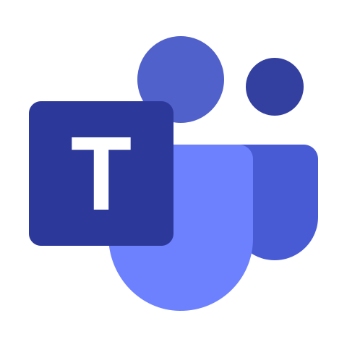

How we built it And why we used the tools we did
Microsoft Graph
Reporting APIs for recent sign ins
List and interact with user profiles
Regenerate invitations
Requirements
Easily available in the flow of work (in teams)
Look and feel like it belongs
SPFx
Familiarity
Write once, run anywhere (don’t tell oracle)
Notes:
Dan

Slide 9
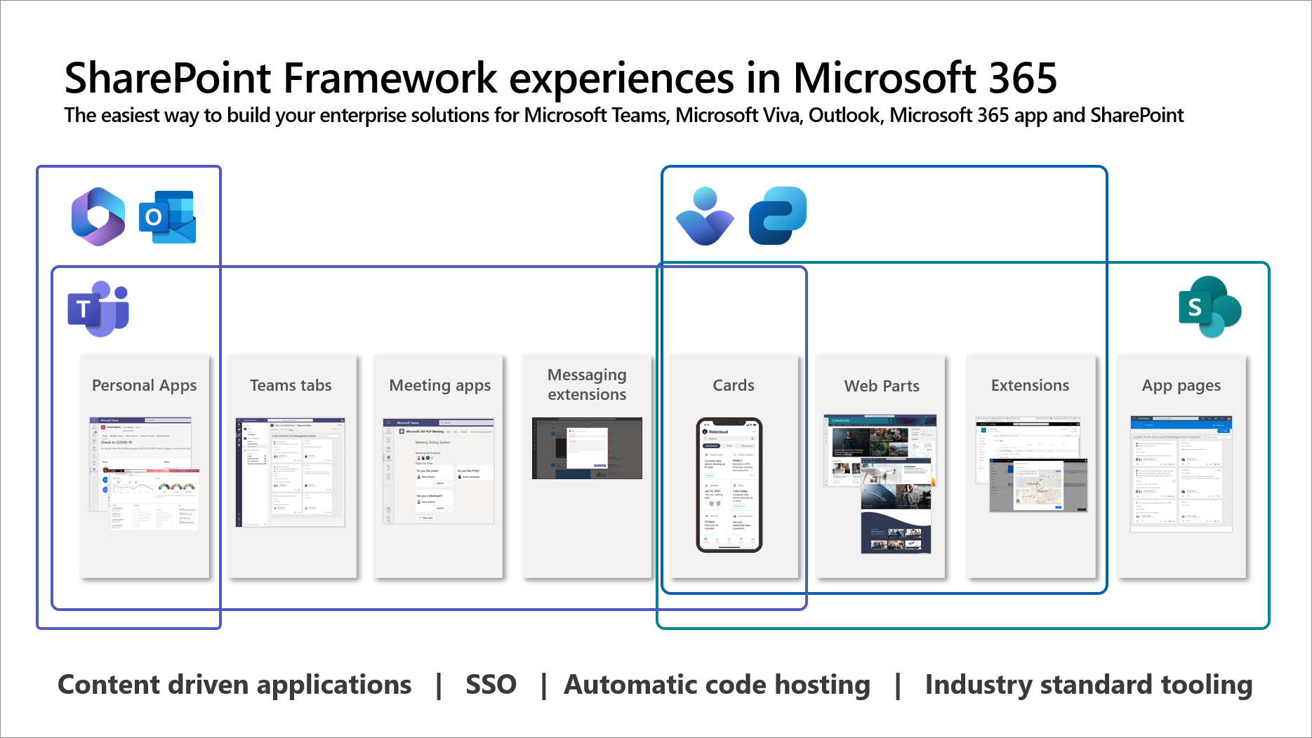
Notes:
Dan

Slide 10
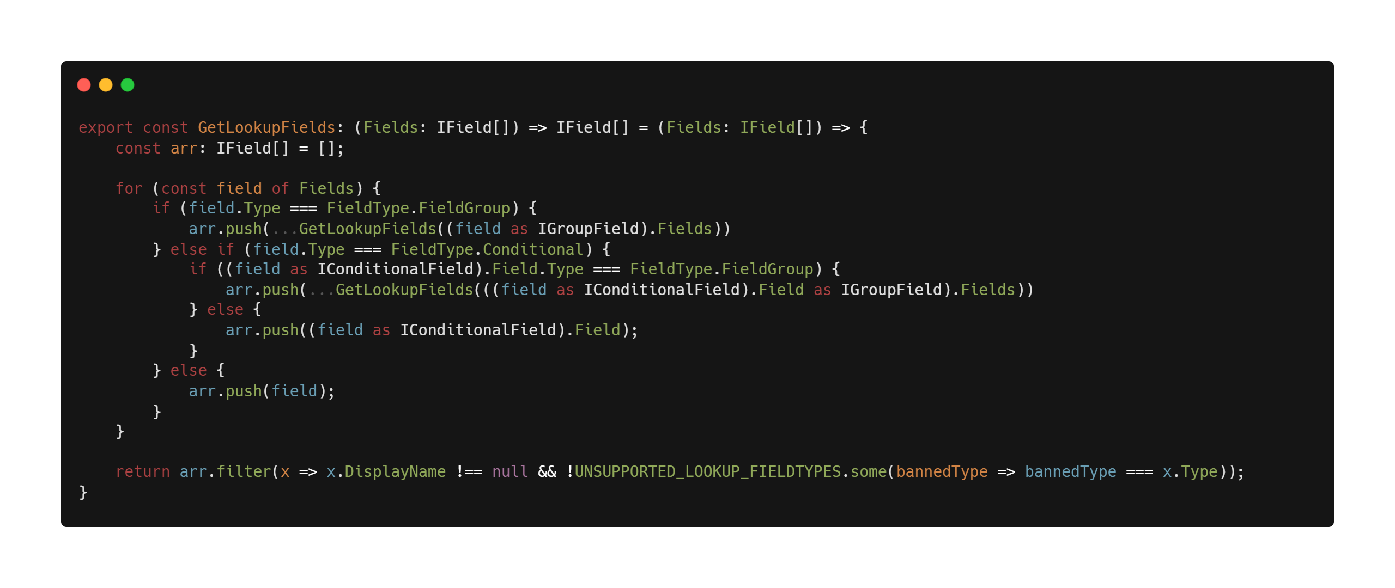
Notes:
Jeppe

Slide 11
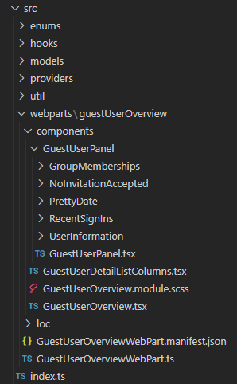
Our solution
Why is it beneficial to segment the code?
Improved maintenance
Reusability
Readability
Collaboration
Testability
Scalability
Framework used
PnPjs
Fluent UI
Notes:
Our solution
Let's talk about the code;
We've aimed to keep it as simple and segmented as possible.
But how did we start the project?
First and foremost, we initiated the project with the Yeoman generator for the SharePoint Framework, aka SPFx as Dan mentioned. Therefore, the structure of the solution may seem familiar.
Yeoman gives a good starting point for a project, because it generates a lot of boilerplate code for us.
But why did we segment the code further?
Because Dan and I were working on the project at the same time, it was easy to divide the tasks and work on the project without making break changes all the time.
However, there are many additional benefits as well.
Segmenting the code brings several advantages. It makes the code more maintainable, scalable, and robust.
It may seem like extra effort at the beginning, but it pays off in the long run, especially as our application grows and evolves over time.
•Improved maintenance
•Reusability
•Readability
•Collaboration
•Testability
•Scalability

Slide 12

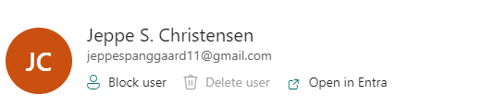
UI/UX made easy!
Fluent UI for creating beautiful, cross-platform apps that share code, design, and interaction behavior
Similar appearance
Custom renders
Notes:
We've made it easy for ourselves by utilizing various frameworks.
For instance, we've used Fluent UI to quickly and easily create a visual interface that resembles Microsoft's design.
For those who may not be familiar with Fluent UI, it's a framework that includes a variety of components and styles that can be integrated directly into your solution and already has a Microsoft look and feel.
Furthermore, the framework contains numerous methods that make it easy to manipulate the output of a component, allowing us to customize it according to our preferences.
Just take a look at these two pictures.
The left one is a standard Persona component, and the right one, is with our custom rendering.
Where we’re joining together several different components into one

Slide 13
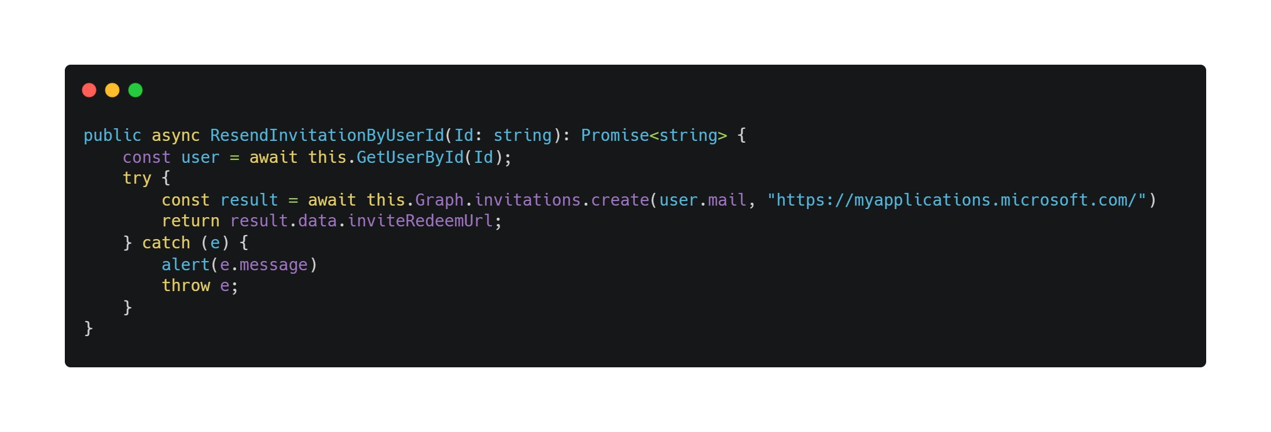
Simplicity with PnPjs
Neatly encapsulated logic
Avoid writing extensive code
Notes:
Similarly, we've employed PnPjs because the framework neatly encapsulates a lot of logic, allowing us to avoid writing extensive code and instead call individual methods.
A good example is the "ResendInvitationByUserId" method.
If we disregard our error handling for a moment, there's a line where you can really see how the logic is neatly encapsulated and presented in a straightforward manner.
Graph > Invitations > Create
The method takes an email address and specifies which URL the user should be invited to.

Slide 14
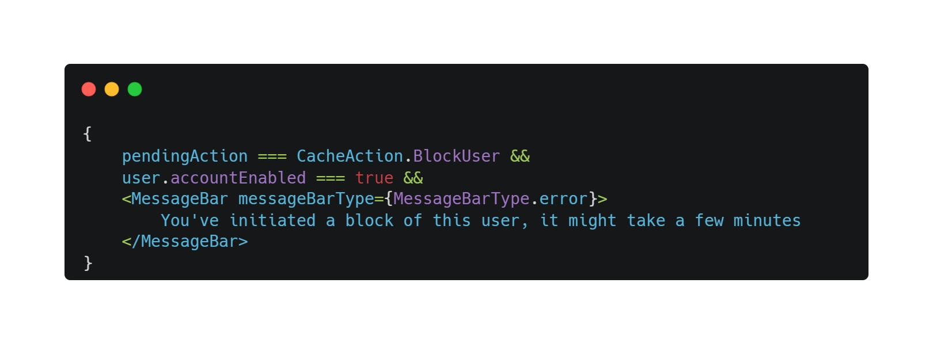
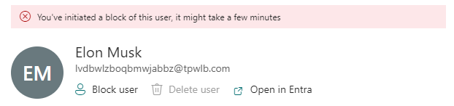
Making the non-instant, instant
Actions are "delayed"
Using caching to our advantage
Notes:
Additionally, when we, for example, block a user, it takes some time for this change to take effect.
Therefore, we make use of caching to keep track of users where a block action has been initiated.
Instead of providing no response when you press "Block User," we store it in a cache.
As a result, we can display that a blocking action has been initiated - see the image.

Slide 15
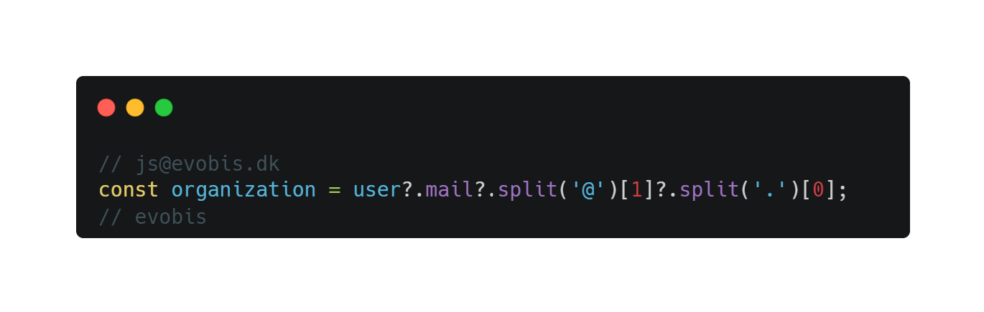
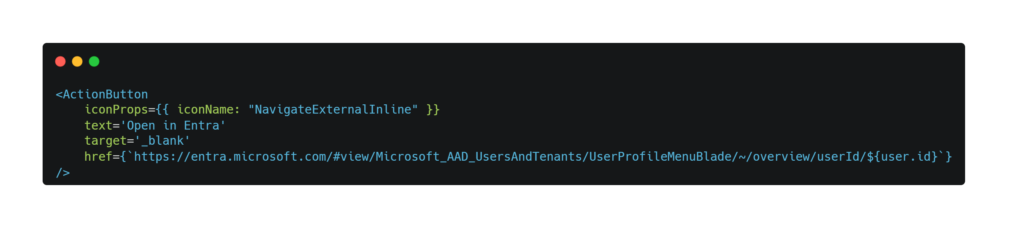
Small but effective
Collecting "organization" from email
Microsoft Entra ID deeplink
Notes:
Additionally, we've incorporated small enhancements that improve the overall user experience with minimal effort.
For instance, when inviting a user and not having all the user's information but only an email address, we've created a "method" that finds the organization the user comes from, Or at least attempts to.
Another feature we've implemented, which is a small but valuable addition, is the ability to deep-link to Entra. It's incredibly easy to set up—all that's needed is a user ID.

Slide 16

Summary
Developing for M365 is made easier by a solid tech-stack
SPFx makes it easy to build something that works everywhere
Graph provides easy access to all your Microsoft 365 data
Community libraries like PnPjs makes it easy
Cross-platform code, design, and interaction behavior
SharePoint
Outlook (Web)
Teams (Desktop, web and mobile)
Hackathons are fun! 🙌
Notes:
Fælles
Cross-platform code, design, and interaction behavior
With the help of SPFx and the other frameworks we've described, it's easy to build a product that can be seamlessly used across platforms, whether it's on the web, desktop, or mobile.
It's the same codebase.

Slide 17
Thank you!
Link: https://github.com/Tanddant/TeamsGuestUserOverview
Slides: https://github.com/Tanddant/Slides
Jeppe Spanggaard
Dan Toft
Microsoft 365 Consultant Denmark
Jeppe-Spanggaard.dk
@JeppeSC11
Microsoft 365 Consultant Denmark
Blog.Dan-Toft.dk
@Tanddant

